Slide 1

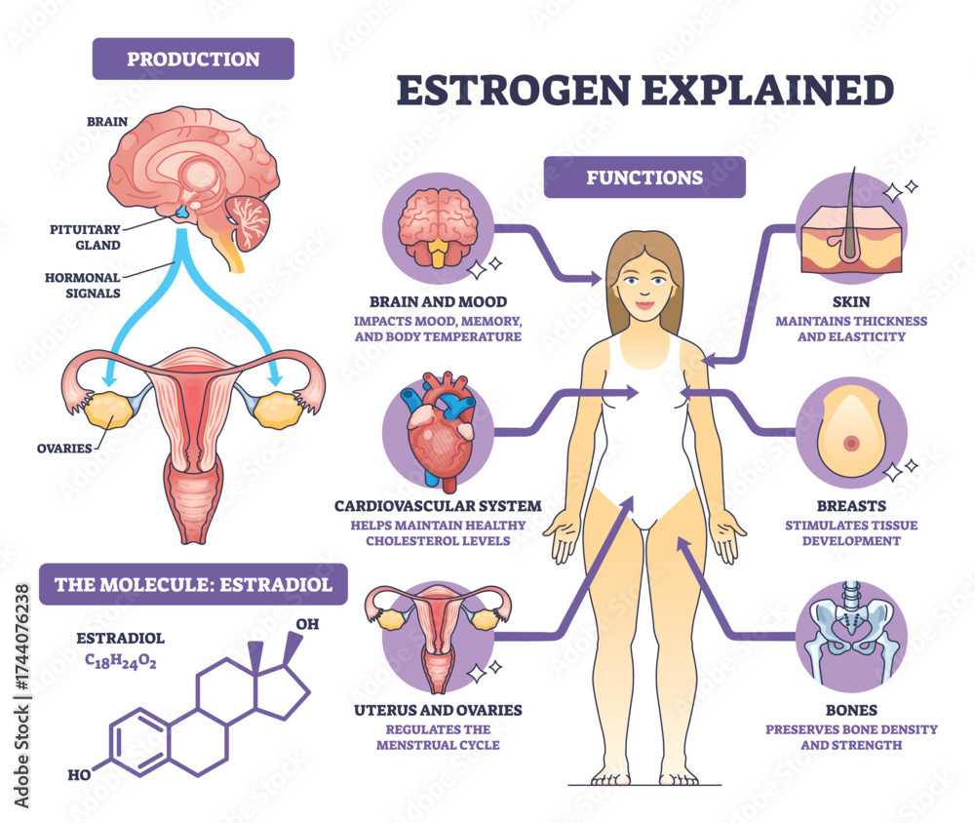
Hormone Therapy with or without Anti-Depressants for the Treatment of Depression in Perimenopausal and Menopausal Women
Jennifer Daley, RN BSN, MPH, MSN-S, FNP-S
University of Colorado Anschutz Medical Campus, College of Nursing, Aurora, CO
PICO
In perimenopausal and menopausal women experiencing depression, how does hormone therapy alone compared to hormone therapy plus an antidepressant affect their depressive symptoms?
Author, Year, Title, Journal and LOE | Study design | Sample and setting/Data analysis | Major Variables and Definitions. | Statistical results that answer PICO | Strengths and Limitations | Outcomes
Tseng et al.; 2022, Pharmacological interventions and hormonal therapies for depressive symptoms in peri- and post-menopausal women: a network meta-analysis of randomized controlled trials, Psychiatry Research LEO I | A systematic review and network meta-analysis of randomized control trials (RCTs) following the 2020 PRISMA Guidelines. Databased searched: PubMed, Cochrane Library, and ScienceDirect Included placebo or active-controlled RCTs Excluded non-RCTs and RCTs that didn’t measure difference in depressive symptoms over time | Sample size: 75 articles with 19,048 perimenopausal or postmenopausal women with a mean age of 59.5 Statistical analysis performed using STATA version 16.0. Primary outcome and subgroups: standardized mean difference (SMD) and 95% confidence intervals. | Primary outcome: difference between depression symptoms before and after treatment with either hormonal medication and/or pharmacological medication; subgroup 1: supported diagnosis of depression; subgroup 2: postmenopausal. | Primary outcome/subgroup 1: Fluoxetine combined with conjugated equine estrogens and cyclic medroxyprogesterone acetate improved depression symptoms better than placebo/control with SMD -1.58 and 95% CI -2.64 to -0.52/SMD -1.87 with 95% CI -3.13 to -0.61. Oral estrogen therapy improved depression symptoms better than placebo/control with SMD -0.54 and 95% CI -0.90 to -0.10. Subgroup 2: Venlafaxine-methyltesterone improved depression symptoms better than placebo/control with SMD -1.57 with 95% CI -2.90 to -0.24. | Strengths: Meta-analysis with large sample size of 19,048 perimenopausal and postmenopausal women; large sample size enabled subgroup analysis. Limitations: Sample included both perimenopausal and postmenopausal women; heterogeneity of participants characteristics. | Treatment with estrogen and an SSRI (fluoxetine) decreased depression symptoms compared to a placebo. Oral estrogen treatment decreased depression symptoms compared to a placebo. In postmenopausal women treatment with methyltestosterone and an SNRI (Venlafaxine) decreased depression symptoms compared to placebo.
Zhang et al., 2023, The effect of exogenous estrogen on depressive mood in women: A systematic review and meta-analysis of randomized controlled trials, Journal of Psychiatric Research LOE I | A systematic review and network meta-analysis of RCTs following the 2009 PRISMA Guidelines. Databased searched: PubMed, Embase, Web of Science, Google Scholar, Cochrane library, PsychINFO, and CINHAL. Included RCTs with females 18 or older; estrogen intervention; confirmed depression diagnosis Excluded non-RCTs, participants with a major disease; participants with a psychiatric disorder other than depression; participants who recently used estrogen medication. | Sample size: 14 articles with 660 females older than 18 years old. Statistical analysis performed using R project versions 4.2.1, R packages meta. Primary outcome and subgroups 1 and 3: standardized mean difference (SMD) and 95% confidence intervals; subgroup 2 SMD and P value; subgroup 4 β, 95% CI and P value. | Primary outcome: change in depressive symptoms after treatment with estrogen and/or antidepressant medication; subgroup 1: comparing postmenopause and perimenopause; subgroup 3: comparing estrogen alone, estrogen plus antidepressant, and estrogen plus progesterone and antidepressant; subgroup 4 correlation between perimenopause, postmenopause and change in depressive symptoms. | Estrogen improved depressive symptoms in all females compared to placebo control with SMD -0.73 with 95% CI -1.09 to -0.38. Postmenopause with SMD -0.40 and 95% CI -0.92 to 0.11. perimenopause with SMD -1.18 and 95% CI -1.61 to -0.75. Estrogen and estrogen plus antidepressant improved depressive symptoms compared to placebo control whereas estrogen plus progesterone and antidepressant did not with SMD -0.17 and 95% CI -1.20 to 0.87. Estrogen medication was more effective in improving depressive symptoms in perimenopause than postmenopause with β 0.0973, 95% CI 0.0303 to 0.1644 and P < 0.01. | Strengths: meta-analysis with moderate sample size of females over 18 years old; subgroup analysis clarified some of the heterogeneity; only included RCTs with confirmed depression diagnosis; and compared drug combinations. Limitations: estrogen medications consisted of different types and doses; heterogeneity of study population; study population did not include Asians. | Treatment with estrogen improved depressive symptoms compared to a placebo. Treatment with estrogen plus an antidepressant improved depressive symptoms compared to a placebo. Estrogen, progesterone, and an antidepressant did not improve depressive symptoms compared to a placebo. Estrogen alone was more effective at treating depressive symptoms in perimenopausal women than in postmenopausal women.
Gnanasegar et al., 2024, Does menopause hormone therapy improve symptoms of depression? Findings from a specialized menopause clinic, Menopause: The Journal of The Menopause Society LOE IV | Cohort study of menopausal women aged 21-72 who attended the St. Joseph's Healthcare Meno- pause Clinic in Hamilton, Ontario, between January 2020 and January 2023. | Sample size: 170 women aged 21-72 Setting: St. Joseph's Healthcare Meno- pause Clinic in Hamilton, Ontario Student’s t test; uni- variate and multivariate repeated measures ANOVA Secondary and tertiary outcomes: binary logic regression; Univariate analysis of variance (ANOVA) | Primary outcome: change in CESD-10 scores at baseline and follow up; subgroup 1: placebo; subgroup 2: treatment with antidepressants; subgroup 3: treatment with HRT; subgroup 4: treatment with HRT and an antidepressant. Secondary outcome: comparing baseline and follow up CESD-10 scores between peri-menopause and postmenopause | Primary outcome: for all subgroups significant decrease in CESD-10 scores overtime, t = 6.4 and P <0.01. Largest decreases in HRT alone with mean change of 2.3 points and HRT plus antidepressant with mean change of 3.9 points; treatment with HRT and antidepressant has a synergistic effect with F[1.161] = 5.20 and P = 0.024. Secondary outcome: having peri-menopause compared to menopause did not affect the CESD-10 scores. | Strengths: prospective cohort study that collected baseline CESD-10 scores and follow up CESD-10 scores after treatment initiation; and used a validated depression scale. Limitations: majority of study participants are white which is not representative of the wider population; majority of participants had higher education which is not representative of the wider population; and the number of participants in each subgroup were not equal. | Overall, treatment with HRT alone and HRT plus an antidepressant decreased depressive symptoms over time. However, HRT plus an antidepressant had the greatest decrease in depressive symptoms over time. HRT plus an antidepressant had a greater effect on depressive symptoms together than monotherapy with either. Being in perimenopause or postmenopause did not affect the depression scale scores.
Discussion
Both meta-analyses indirectly answer the PICO question since they don’t compare HRT alone and HRT with an antidepressant, directly; but they do show that HRT alone and HRT with an antidepressant decreased depressive symptoms when compared to a placebo.^{8,9}
The Zhang et al. (2023) meta-analysis showed a greater decrease in depressive symptoms in perimenopausal women.⁹
The Cohort study answers the PICO question since it shows statistically significant decreases in depressive symptoms in both peri-menopausal and menopausal women over time while taking either HRT alone or taking both HRT and an antidepressant.⁴
Background
80% of perimenopausal and menopausal women experience signs and symptoms related to the fluctuating hormones during the transition from menstruation to menopause.⁶
The Study of Women’s Health Across the Nation reported higher Center for Epidemiological Studies Depression Scale (CESD) scores in perimenopausal and menopausal women.²
Orem’s Self-Care Deficit Theory ⁷
Comprised of self-care, self-care deficit, and nursing systems theories
Healthy adults are capable of self-care and maintain their physical and mental health.
When a patient is incapable of maintaining their physical and mental health, they are in a self-care deficit and require nursing assistance.
Nursing assistance for depressive symptoms in perimenopause and menopause includes education and supplying the patient with HRT alone or HRT and an antidepressant to reduce the depressive symptoms and prevent worsening symptoms.
Pathophysiology
As ovaries age and follicles fail the secretion of estrogen and progesterone fluctuate widely until the ovaries shutdown and low levels of estrogen are maintained.²
Areas of the brain that regulate mood and emotions have estrogen, progesterone, and aldosterone receptors suggesting that the fluctuations of hormone levels may contribute to mood changes.²
Estrogen regulates the synthesis, uptake, and number of receptors for serotonin, dopamine, and norepinephrine. Decreases in these hormones are involved in the pathogenesis of depression and anxiety.²
Application to Practice
Compelling evidence for prescribing HRT alone or HRT with an antidepressant to treat depressive symptoms during perimenopause and menopause.
Within our scope of practice to discuss using HRT alone or HRT and an antidepressant with our perimenopausal and menopausal patients.
Need more studies including RCTs that directly compare HRT alone to HRT plus an antidepressant.
Also need studies that includes a more diverse population that matches our patient populations.
Pharmacology
Estrogen^{1,2}
Selective serotonin reuptake inhibitors³
Serotonin norepinephrine reuptake inhibitors⁵
Contact Information
Jennifer.daley@cuanschutz.edu
Notes:
Vasomotor symptoms, insomnia, mood changes, fatigue, anxiety, palpitations, vaginal dryness, dyspareunia, urinary symptoms, brain fog, joint pain, nail thinning, dry skin, and dry eyes
Estrogen regulates menstrual cycle and ovulation, mood, memory, body temperature, heart beats, cholesterol levels, skin thickness and elasticity, breast development, bone density
Nursing assistance includes fully taking over self-care needs, partially taking over self-care needs, and/or educating or directing the patient’s self-care.

Slide 2
References
1. Adobe Stock. (2026). Estrogen explained. [Diagram]. Adobe Stock. https://stock.adobe.com/images/estrogen-brief-diagram-shows-hormone-production-and-functions-across-body-highlights-uterus-brain-and-estradiol-structure-outline-diagram/1744076238
2. Fidecicchi, T., Giannini, A., Chedraui, P., Luisi, S., Battipaglia, C., Genazzani, A. R., Genazzani, A. D., & Simoncini, T. (2024). Neuroendocrine mechanisms of mood disorders during menopause transition: A narrative review and future perspectives. Maturitas, 188, 108087. https://doi.org/10.1016/j.maturitas.2024.108087
3. Goodnick, P. J., & Goldstein, B. J. (1998). Selective serotonin reuptake inhibitors in affective disorders--I. Basic pharmacology. Journal of psychopharmacology (Oxford, England), 12(3 Suppl B), S5–S20. https://doi.org/10.1177/0269881198012003021
4. Gnanasegar, R., Wolfman, W., Galan, L. H., Cullimore, A., & Shea, A. K. (2024). Does menopause hormone therapy improve symptoms of depression? Findings from a specialized menopause clinic. Menopause (New York, N.Y.), 31(4), 320–325. https://doi.org/10.1097/GME.0000000000002325
5. Singh, D., & Saadabadi, A. (2024). Venlafaxine. In StatPearls. StatPearls Publishing.
6. Talaulikar V. (2022). Menopause transition: Physiology and symptoms. Best practice & research. Clinical obstetrics & gynaecology, 81, 3–7. https://doi.org/10.1016/j.bpobgyn.2022.03.003
7. Tanaka M. (2022). Orem's nursing self-care deficit theory: A theoretical analysis focusing on its philosophical and sociological foundation. Nursing forum, 57(3), 480–485. https://doi.org/10.1111/nuf.12696
8. Tseng, P. T., Chiu, H. J., Suen, M. W., Zeng, B. S., Wu, M. K., Tu, Y. K., Hung, K. C., Wu, Y. C., Su, K. P., Li, D. J., Chen, T. Y., Stubbs, B., Carvalho, A. F., Solmi, M., Thompson, T., Caruso, M. G., Matsuoka, Y. J., Chen, Y. W., Lin, P. Y., Sun, C. K., … Shiue, Y. L. (2023). Pharmacological interventions and hormonal therapies for depressive symptoms in peri- and post-menopausal women: a network meta-analysis of randomized controlled trials. Psychiatry research, 326, 115316. https://doi.org/10.1016/j.psychres.2023.115316
9. Zhang, J., Yin, J., Song, X., Lai, S., Zhong, S., & Jia, Y. (2023). The effect of exogenous estrogen on depressive mood in women: A systematic review and meta-analysis of randomized controlled trials. Journal of psychiatric research, 162, 21–29. https://doi.org/10.1016/j.jpsychires.2023.04.002

